Slide 1
MA6351 TRANSFORMS AND PARTIAL
DIFFERENTIAL EQUATIONS
UNIT III
APPLICATIONS OF PARTIAL DIFFERENTIAL EQUATIONS

Slide 2
UNIT SYLLABUS
Classification of PDE – Method of separation of variables - Solutions of one dimensional wave equation – One dimensional equation of heat conduction – Steady state solution of two dimensional equation of heat conduction (excluding insulated edges).

Slide 3

CLASSIFICATION OF PARTIAL DIFFERTENTIAL EQUATION

Slide 4




EXAMPLE 1:
SOLUTION:

Slide 5

EXAMPLE 2:
SOLUTION:
EXAMPLE 3:

Slide 6

SOLUTION:

Slide 7
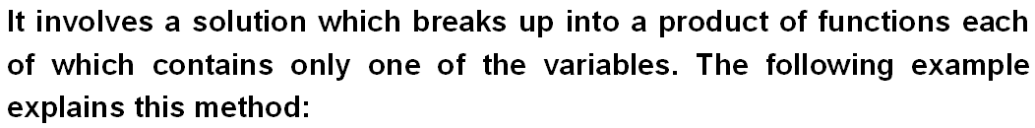
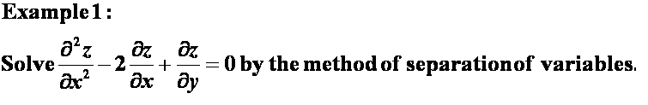
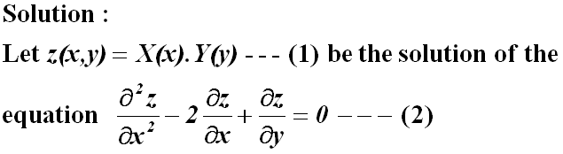

METHOD OF SEPARATION OF VARIABLES

Slide 8
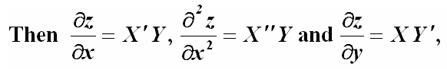


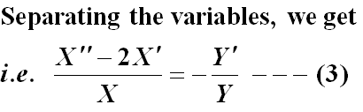




Slide 9



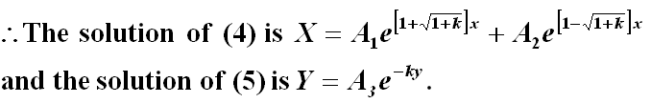

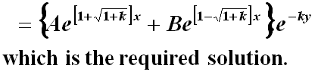

Slide 10
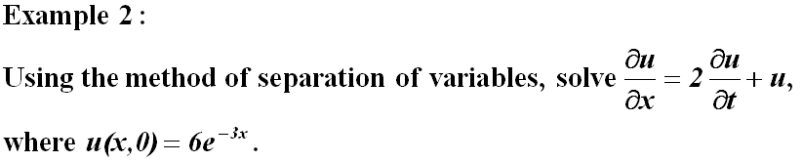
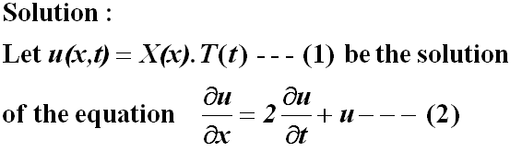
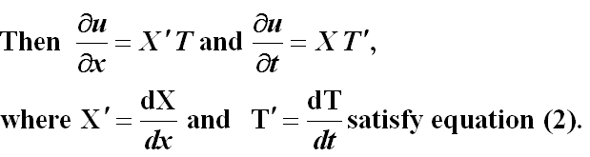

Slide 11






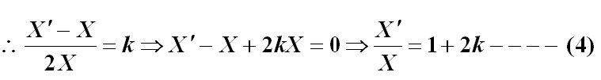

Slide 12





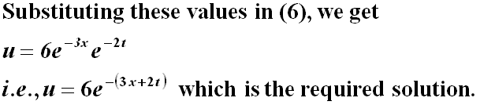

Slide 13
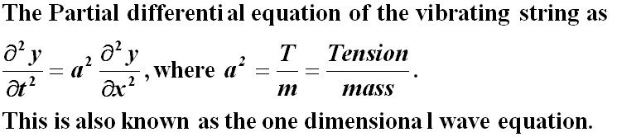
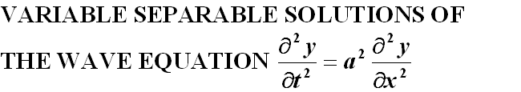


TRANSVERSE VIBRATIONS OF A STRETCHED STRING
(ONE DIMENSIONAL WAVE EQUATION)

Slide 14
EXAMPLE 1:
Solution:

Slide 15
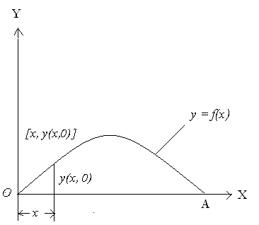
The initial and boundary conditions are given by

Slide 21
EXAMPLE 2:
Solution:

Slide 22
The initial and boundary conditions are given by

Slide 27
Example 3:
A tightly stretched string of length 2l is fastened at both ends. The midpoint of the string is displaced by a distance ‘b’ transversely and the string is released from rest in this position. Find the displacement of any point of the string at any subsequent time.
Solution:
Let us find the analytic equation of the curve which the string assumes initially.

Slide 28
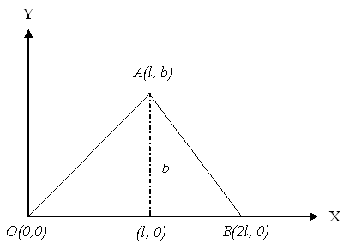

Slide 30
The initial and boundary conditions are given by

Slide 37
Example 4:
A tightly stretched string with fixed end points x = 0 and x = l is Initially at rest in its equilibrium position. If it is set vibrating by giving each point a velocity kx(l – x). Find the displacement of the string at any time.
Solution:

Slide 40
Since the partial differential equation is linear, any linear combination of solutions of the form (4) with n = 1,2,3,… is also a solution of the equation.

Slide 43
ONE – DIMENSIONAL HEAT FLOW EQUATION

Slide 44
VARIABLE SEPARABLE SOLUTIONS OF THE HEAT EQUATION

Slide 45
CHOICE OF PROPER SOLUTION
When heat flow is under steady state conditions, the
temperature at any point does not vary with time, that is
it is independent of time. Hence the proper solution in
steady state heat flow problem is u(x, t) = Ax + B.

Slide 46
Example 1:
State any two laws which are assumed to derive one dimensional heat equation?
Solution:
Heat flows from higher to lower temperature
The amount of heat required to produce a given temperature
change in a body is proportionality is known as the specific
heat (s) of the conducting material.

Slide 47
Example 2:
State the Fourier law of heat conduction.
Solution:
The rate at which heat flows across any area is proportional to the area and to the temperature gradient normal to the curve. This constant of proportionality is known as thermal conductivity (k) of the material. It is known as Fourier law of heat conduction.

Slide 48
Example 3:
Define steady state and derive the steady state solution of one dimensional heat equation.
Solution:
Steady state is the state in which the temperature does not vary with respect to the time.

Slide 49
Example 4:
The bar of length 50cm has its ends kept at 20˚C and 100˚C until steady state condition prevails. Find the steady state temperature of the rod.
Solution:

Slide 50
Example 5:
What is the basic difference between the solutions of one Dimensional wave equation and one dimensional heat equation.
Solution:
Solution of one dimensional wave equation is of periodic in nature. But solution of one dimensional heat equation is not of periodic in nature.

Slide 51
Example 6:
A rod of length 20 cm has its ends A and B kept at 30˚C and 90˚C respectively, until steady state conditions prevail. If the temperature at each end is then suddenly reduced to 0˚C and maintained so, find the temperature u(x, t) at a distance x from A at time t.
Solution:

Slide 57
Example 7:
A bar 10cm long with insulated sides has its ends A and B kept at 20˚C and 40˚C respectively, until steady state conditions prevail. The temperature at A is then suddenly raised to 50˚C and at the same instant that B is lowered to 10˚C . Find the temperature distribution in the rod at time t. Also show that the temperature at the midpoint of the rod remains unaltered for all time, regardless of the material of the rod.
Solution:

Slide 59
Now the temperatures at A and B are changed, the state is no longer steady. For this transient state the boundary conditions are

Slide 65
(i.e.) The temperature at the midpoint of the rod remains
unaltered for all time.

Slide 66
TWO – DIMENSIONAL HEAT FLOW EQUATION

Slide 67
VARIABLE SEPARABLE SOLUTIONS OF LAPLACE EQUATION
The possible solutions of steady state two dimensional heat
Equation (or Laplace equation) are

Slide 68
CHOICE OF PROPER SOLUTION
CASE (i)
If the non – zero boundary value is prescribed either on x = 0 or x = a (in which y is varying), that solution in which periodic functions in y occur will be the proper solution.
CASE (ii)
If the non – zero boundary value is prescribed either on y = 0 or y = b (in which x is varying), that solution in which periodic functions in x occur will be the proper solution.

Slide 69
Example 1:
A square plate is bounded by the lines x = 0, y = 0, x = 20 and y = 20. Its faces are insulated. The temperature along the upper horizontal edge is given by u(x, 20) = x(20 – x) when 0 < x < 20 while the other three edges are kept at 0˚C . Find the steady state temperature in the plate.
Solution

Slide 70
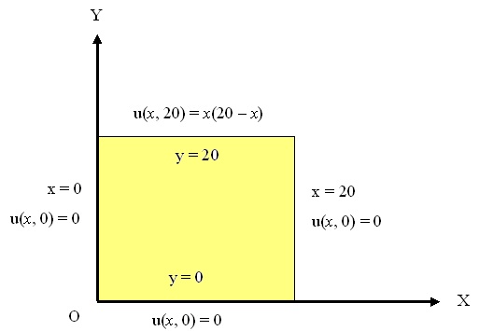

Slide 76
Example 2:
Solution

Slide 79
This is possible only when c₁ = 0

Slide 83
THANK YOU

